Slide 1
Multithreading and Concurrency - Part II

Slide 2
Creating a
Closer Relationship Between Thread
Multithreading not always loosely coupled
Caller may need results from worker
May need to know if task succeeded
Tasks

Slide 3
Thread Result Manual Handling
Process
result
Memory
result

Slide 4
Thread Exception Manual Handling
Process
Exception Info
Memory
Exception

Slide 5
Thread Result Handling Desired
Process
Memory
result

Slide 6
Thread Exception Handling Desired
Process
Memory
Exception

Slide 7
Callable interface
Represents a task to be run on a thread
Can return results
Can throw exceptions
Only member is the call method
Threading Relationship
Types
Future interface
Represents results a thread task
Returned by ExecutorService.submit
The key method is get
Blocks until task completes
Returns Callable interface result
Throws Callable interface exception

Slide 8

Adder Method Returning a Value
public void doAdd() throws IOException int total = 0;
String line = null;
try (BufferedReader reader = Files.newBufferedReader(Paths.get(inFile))) { while ((line = reader.readLine()) != null)
total += Integer.parseInt(inline);
}
try (BufferedWriter writer = Files.newBufferedWriter(Paths.get(outFile))) { writer.write(“Total: " + total);
}
}

Slide 9
Adder Method Returning a Value
public int doAdd() throws IOException {
int total = 0;
String line = null;
try (BufferedReader reader = Files.newBufferedReader(Paths.get(inFile))) {
while ((line = reader.readLine()) != null)
total += Integer.parseInt(inline);
}
try (BufferedWriter writer = Files.newBufferedWriter(Paths.get(outFile))) { writer.write(“Total: " + total);
}
}
doAdd

Slide 10
Adder Method Returning a Value
public int () throws IOException int total = 0;
String line = null;
try (BufferedReader reader = Files.newBufferedReader(Paths.get(inFile))) { while ((line = reader.readLine()) != null)
total += Integer.parseInt(inline);
}
return total;
}
doAdd

Slide 11
Adder Implementing Callable
class Adder implements private String inFile;
public Adder(String inFile) { . . . }
public int doAdd() throws IOException { . . . }
Runnable {
public void
try {
run() {
doAdd();
} catch(IOException e) { . . . }
}
}

Slide 12
Adder Implementing Callable
class Adder implements private String inFile;
Callable <Integer> {
public Adder(String inFile) { . . . }
public int doAdd() throws IOException { . . . }
public
Integer call() throws IOException {
return doAdd();
}
}

Slide 13
Start Adder Processing
String[] inFiles = {“./file1.txt”, . . . “./file6.txt”};
ExecutorService es = Executors.newFixedThreadPool(3);
for(int i=0; i < inFiles.length; i++) { Adder adder = new Adder(inFiles[i]);
es.submit(adder);
}

Slide 14
Start Adder Processing
String[] inFiles = {“./file1.txt”, . . . “./file6.txt”};
ExecutorService es = Executors.newFixedThreadPool(3); Future<Integer>[] results = new Future[inFiles.length]; for(int i=0; i < inFiles.length; i++) {
Adder adder = new Adder(inFiles[i]);
results[i]
= es.submit(adder);
}

Slide 15
Retrieving Adder Class Results
for(Future<Integer> result:results) {
try {
int value = result.get(); // blocks until return value available System.out.println(“Total: “ + value);
} catch(ExecutionException e) { // Exception raised in Adder Throwable adderEx = e.getCause(); // Get the Adder exception
// Do something with adderEx
} catch(Exception e) { . . . } // Non-Adder exceptions
}
es.shutdown();

Slide 16
The challenge of concurrency
Threads sometimes share resources
No problem if resources only read
Changes must be coordinated
Concurrency
Issues
Failure to coordinate can create problems
Receive wrong results
Crash the program

Slide 17
A Simple Bank Account Class
public class BankAccount { private int balance;
public BankAccount(int startBalance) { balance = startBalance;
}
public int getBalance() { return balance;
}
public void deposit(int amount) { balance += amount;
}
}

Slide 18
A Class to Update the Bank Account
public class Worker implements Runnable { private BankAccount account;
public Worker(BankAccount account) { this.account = account;
}
public void run() {
for(int i=0; i < 10; i++) {
int startBalance = account.getBalance(); account.deposit(10);
int endBalance = account.getBalance();
}
}
}

Slide 19
Running on a Single Thread
ExecutorService es = Executors.newFixedThreadPool(5); BankAccount account = new BankAccount(100);
End Balance: 110 StartBalance: 100
End Balance: 120 StartBalance: 110
End Balance: 130 StartBalance: 120
End Balance: 140 StartBalance: 130
End Balance: 150 StartBalance: 140
End Balance: 160 StartBalance: 150
End Balance: 170 StartBalance: 160
End Balance: 180 StartBalance: 170
End Balance: 190 StartBalance: 180
End Balance: 200 StartBalance: 190
Worker worker = new Worker(account); es.submit(worker);
// Shutdown es and wait

Slide 20
Running on Multiple Threads
ExecutorService es = Executors.newFixedThreadPool(5); BankAccount account = new BankAccount(100);
for(int i = 0; i < 5; i++) {
Worker worker = new Worker(account); es.submit(worker);
}
// Shutdown es and wait

Slide 22
What Happened on the 5 Threads
End Balance: 110 Start Balance: 100 Worker: 1
End Balance: 120 Start Balance: 110 Worker: 2
End Balance: 130 Start Balance: 120 Worker: 3
End Balance: 140 Start Balance: 130 Worker: 4
End Balance: 150 Start Balance: 140 Worker: 5
End Balance: 160 Start Balance: 150 Worker: 5
End Balance: 170 Start Balance: 160 Worker: 3
End Balance: 170 Start Balance: 160 Worker: 2
End Balance: 510 Start Balance: 500 Worker: 4
End Balance: 520 Start Balance: 510 Worker: 5
End Balance: 520 Start Balance: 510 Worker: 1
End Balance: 530 Start Balance: 520 Worker: 2
End Balance: 540 Start Balance: 530 Worker: 3
End Balance: 550 Start Balance: 540 Worker: 3

Slide 23
There’s More Than Meets the Eye
public class BankAccount { private int balance;
public BankAccount(int startBalance) { balance = startBalance;
}
public int getBalance() { return balance;
}
public void deposit(int amount) { balance += amount;
}
}
Read current value from memory
Perform addition
Write result back to memory

Slide 24
Unprotected Concurrency
Process
Thread 0 (a.k.a. Main Thread)
account
Thread 1
510
balance
520
510
520
520
510
Thread 5
Time

Slide 25
Coordinated Concurrency
Process
Thread 0 (a.k.a. Main Thread)
account
Thread 1
510
balance
520
510
520
530
530
520
Thread 5
Time

Slide 26
Synchronized methods
Coordinate thread access to methods
Use synchronized method modifier
Class can have as many as needed
Synchronization managed per instance
No more than one thread can be in any synchronized method at a time
Coordinating Method Access

Slide 27
When to use synchronized
Protect modification by multiple threads
Reading value that might be modified by another thread
Using Synchronized
Methods
Why not always synchronize methods
Has significant overhead
Use only in multithreading scenarios
Constructors are never synchronized
- A given object instance always created on exactly one thread

Slide 28
Synchronized Methods on Bank Account Class
public class BankAccount { private int balance;
public BankAccount(int startBalance) { balance = startBalance;
}
public synchronized int getBalance() { return balance;
}
public synchronized
void deposit(int amount) {
balance += amount;
}
}

Slide 29
5 Threads Running Correctly
100 +10 +10 +10 +10 +10 +10 +10 +10 +10 +10
+10 +10 +10 +10 +10 +10 +10 +10 +10 +10
+10 +10 +10 +10 +10 +10 +10 +10 +10 +10
+10 +10 +10 +10 +10 +10 +10 +10 +10 +10
+10 +10 +10 +10 +10 +10 +10 +10 +10 +10
= 600
5 Threads

Slide 30

Behavior of Synchronized Methods
Process
Thread 0 (a.k.a. Main Thread)
account
Thread 1
510
balance
510
520
520
530
530
520
Thread 5
Time

Slide 31
Synchronized methods
Automated concurrency management
Used lock of current object instance
All Java objects have a lock
Can manually acquire that lock
Use synchronized statement block
Available to any code with a reference
Manual Synchronization

Slide 32
Synchronized Method
class BankAccount { private int balance; // other members elided for clarity public synchronized void deposit(int amount) { balance += amount;
} } | clas pri | s Worker implements Runnable { vate BankAccount account ;
 | // other members elided for clarity public void run() { for(int i=0; i<10; i++) { a.dcecpoousnit(10); } } }

Slide 33
Synchronized Statement Block
class BankAccount { private int balance; // other members elided for clarity
public void deposit(int amount) { balance += amount; } } | clas pri // pub |  |  | s Worker implements Runnable { vate BankAccount account ; other members elided for clarity lic void run() {
 | } | } | for(int i=0; i<10; i++) { synchronized(account ) { .daecpcoosuitn(1t 0); } }

Slide 34
Why Use Synchronized Statement
Blocks
Synchronized blocks provide flexibility
Enables use of non-thread safe classes
Can protect complex blocks of code
Sometimes synchronized methods just aren’t enough

Slide 35
Bank Account Class Revisited
public class BankAccount { private int balance;
public BankAccount(int startBalance) { balance = startBalance; }
public synchronized int getBalance() { return balance;
}
public synchronized void deposit(int amount) { balance += amount;
}
public synchronized void withdrawal(int amount) { balance -= amount;
}
}

Slide 36
Transaction Worker
public class TxWorker implements Runnable { protected BankAccount account;
protected char txType; // ‘w’ -> withdrawal, ‘d’ -> deposit protected int amt;
public TxWorker(BankAccount account, char txType, int amt) { . . . }
public void run() { if (txType == ‘w’)
account.withdrawal(amt); else if (txType == ‘d’) account.deposit(amt);
}
}

Slide 37
Dispatching Transactions
ExecutorService es = Executors.newFixedThreadPool(5); TxWorker[] workers = // Retrieve TxWorker instances
for(TxWorker worker:workers) es.submit(worker);
// Shutdown es and wait

Slide 38
Transaction Worker
public class TxWorker implements Runnable { protected BankAccount account;
protected char txType; // ‘w’ -> withdrawal, ‘d’ -> deposit protected int amt;
public TxWorker(BankAccount account, char txType, int amt) { . . . }
public void run() { if (txType == ‘w’)
account.withdrawal(amt); else if (txType == ‘d’) account.deposit(amt);
}
}

Slide 39
Transaction Promo Worker
public class TxPromoWorker extends TxWorker {
public TxPromoWorker(BankAccount account, char txType, int amt) { super(. . .) }
public void run() { if (txType == ‘w’)
account.withdrawal(amt);
else if (txType == ‘d’) { account.deposit(amt); if(account.getBalance() > 500) {
int bonus = (int)((account.getBalance() – 500) * 0.1); account.deposit(bonus);
}
}
}
}

Slide 40
Dispatching Transactions
ExecutorService es = Executors.newFixedThreadPool(5); TxWorker[] workers = // Retrieve TxPromoWorker instances
for(TxWorker worker:workers) es.submit(worker);
// Shutdown es and wait

Slide 41
Behavior of Synchronized Methods
Process
Thread 0 (a.k.a. Main Thread)
d | 150
deposit get get deposit
account
150
-20
balance
450
600
300
280
300
withdrawal
w | 300
Time

Slide 42
Thread Safe Transaction Promo Worker
public void run() { if (txType == ‘w’)
account.withdrawal(amt);
else if (txType == ‘d’) {
synchronized(account) { account.deposit(amt); if(account.getBalance() > 500) {
int bonus = (int)((account.getBalance() – 500) * 0.1); account.deposit(bonus);
}
}
}
}

Slide 43
Behavior of Synchronized Methods
Process
Thread 0 (a.k.a. Main Thread)
^{d | 150} deposit get get deposit
account
150
10
balance
450
600
synchronized
610
310
300
withdrawal
w | 300
Time

Slide 44
Concurrency and collections
Collections and Concurrency
Concurrency safe collection access
Blocking collections

Slide 45
Synchronized collection wrappers
Most collections are not thread safe
Can create thread safe wrapper
Use Collection class static methods
Concurrency Safe Collection
Access
synchronizedList
synchronizedMap
Etc.
Wrapper is a thread safe proxy
Actual work occurs in original object

Slide 46
Coordinating producers and consumers
One or more threads produce content
One or more other threads consume
Must wait for content if not available
Blocking Collections
Java provides blocking queues
Attempt to read blocks if empty
Wakes up when content available
Examples
LinkedBlockingQueue
PriorityBlockingQueue
Etc.

Slide 47
java.util.concurrent
Types for managing concurrency
Has much of what we’ve talked about
Semaphores
Coordinate access to multiple resources
Lots more
Java Provides
Still More
java.util.concurrent.atomic
Types providing atomic operations
set, get, getAndAdd, compareAndSet

Slide 48
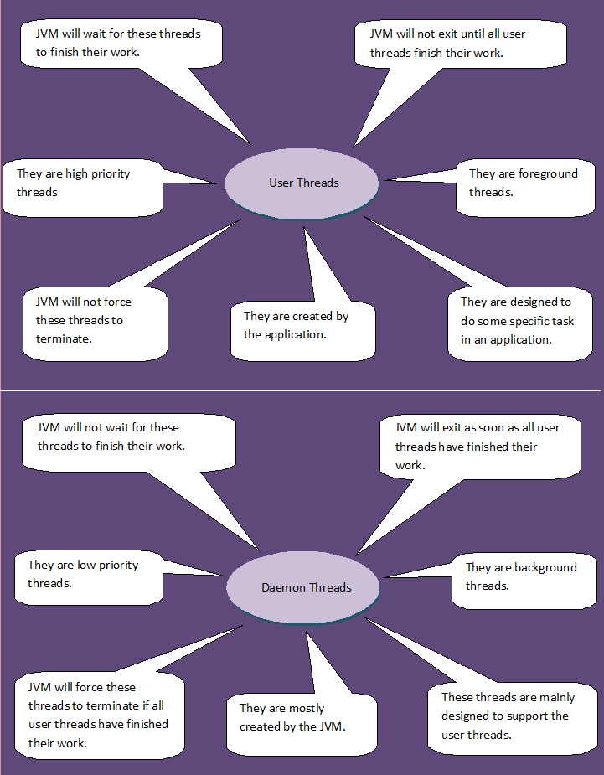
Daemon Thread in Java

Slide 49
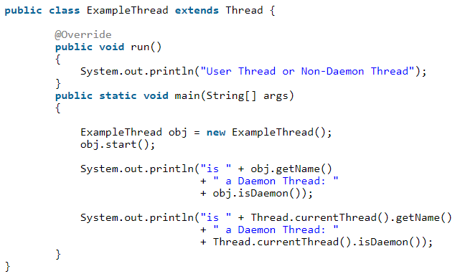
Check whether a thread is a daemon or non-daemon thread

Slide 50
public void setDaemon(boolean status)
Marks this thread as either a daemon thread or a user thread(non-daemon thread).
Methods in Java Daemon Thread
public boolean isDaemon()
Used to test if this thread is a daemon thread or not.
Returns true if the thread is Daemon else false.

Slide 51
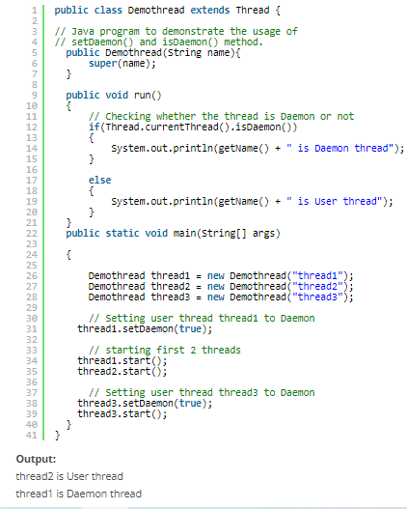
Methods in Java Daemon Thread

Slide 52
This class provides thread-local variables.
- Each thread that accesses one (via its get or set method) has its own, independently initialized copy of the variable.
- Each thread holds an implicit reference to its copy
of a thread-local variable as long as the thread is alive and the ThreadLocal instance is accessible
Java Thread Local
ThreadLocal instances are typically private static fields in classes that wish to associate state with a thread (e.g., a user ID or Transaction ID).
After a thread goes away, all of its copies of thread-local instances are subject to garbage collection (unless other references to these copies exist).

Slide 53
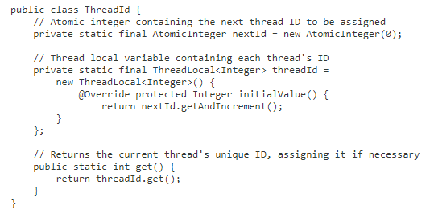
public class ThreadLocal<T> extends Object
This class generates unique identifiers
local to each thread.
A thread's id is
assigned the first
time it invokes
ThreadId.get() and remains unchanged
on subsequent calls.

Slide 54
Snapshot of the state of all the threads of a Java process
- jstack
Java Thread Dump
- Java Mission Control
- jvisualvm
- jcmd
- jconsole

Slide 55
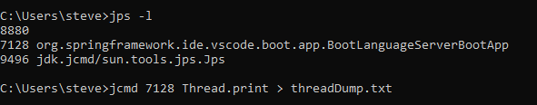
Generating a Thread Dump

Slide 56
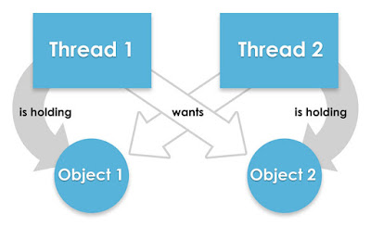
We cannot resolve deadlock but we can avoid deadlock situation based on several techniques.
Deadlock in java
- When two threads are waiting for each other forever means (i.e. it does not get a chance to enter in a ready queue) such type of infinite waiting is called deadlock.
- A deadlock occurs when the waiting process is still holding onto another resource that the first needs before it can finish.
- By using synchronized keyword we may move towards deadlock situation. Synchronize keyword is not recommended to apply unnecessarily.

Slide 57
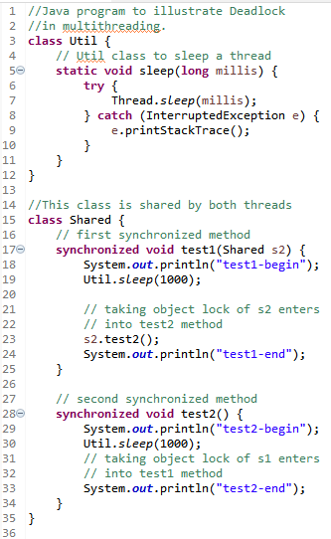
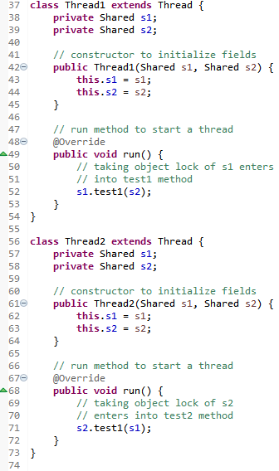
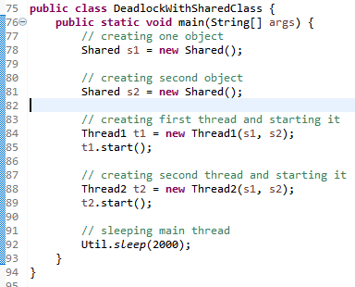
Deadlock With A Shared Class

Slide 58
We cannot resolve deadlock but we can avoid deadlock situation based on several techniques.
Avoid Dead Lock condition
- Avoid Nested Locks
- Avoid Unnecessary Locks
- Using thread join

Slide 59
The Timer class schedules a task to run at a given time once or repeatedly.
Java Timer Thread
- It can also run in the background as a daemon thread.
- The Timer schedules a task with fixed delay as well as a fixed rate.
- The Timer class provides a cancel() method to cancel a timer.
- The Timer class executes only the task that implements the TimerTask.

Slide 60
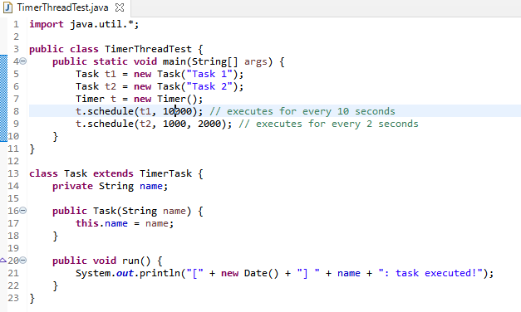
Implement a timer thread in Java

Slide 61
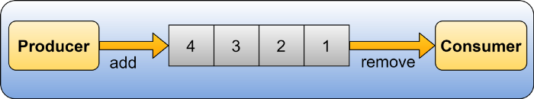
The Producer-Consumer Problem (sometimes called the Bounded-Buffer Problem) is a classic example of a multi-threaded synchronization problem.
Producer - Consumer Problem
in Java Multi-Threading
- The Producer produces an item, puts that item into the buffer, and keeps repeating this process.
- On the other hand, the Consumer is consuming the item from the shared buffer, one item at a time.

Slide 62
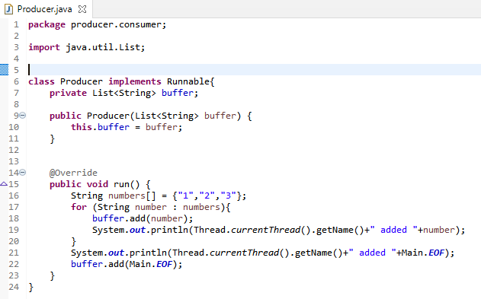
Producer Thread

Slide 63
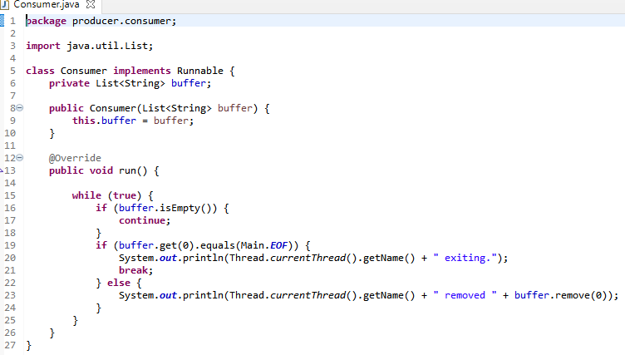
Consumer Thread

Slide 64
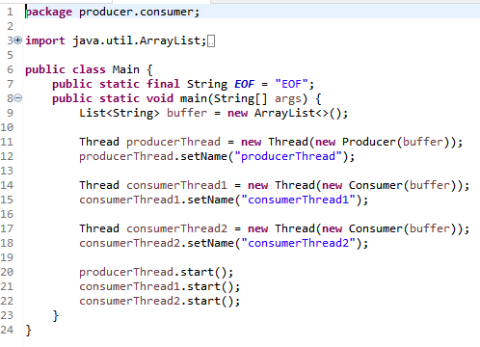
Calling Thread

Slide 65
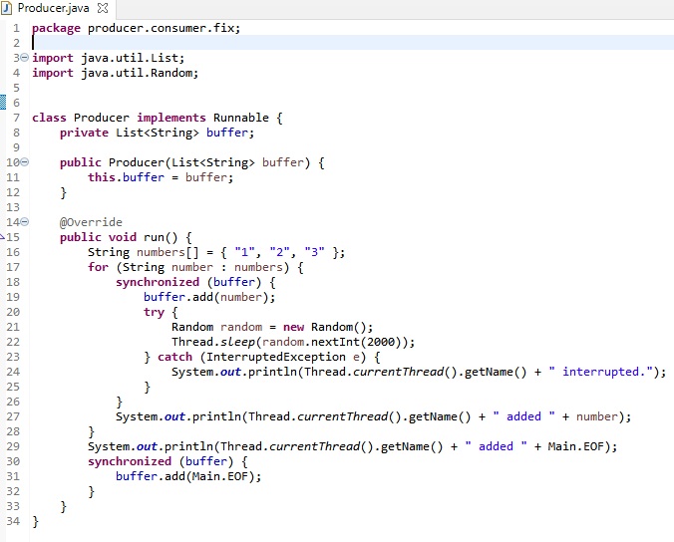
Fix the Producer

Slide 66
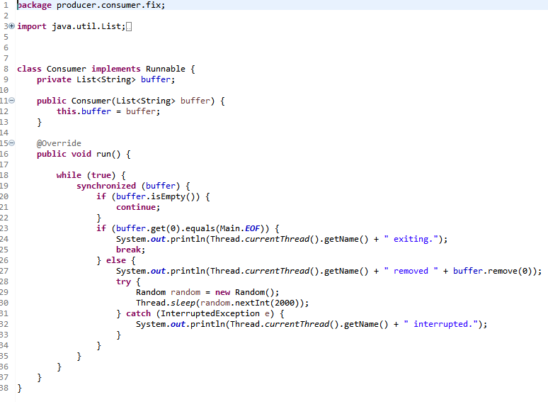
Fix the Consumer

Slide 67

Thread class
Represents a thread of execution
Similar to most OS thread representations
Responsible to handle most details
Summary
Runnable interface
Represents a task to run on a thread
Simply override run method
Can’t return results
Exceptions responsibility of thread

Slide 68
ExecutorService
Abstracts thread management details
Can interact with thread pools
Summary
Callable interface
Represents a task to be run on a thread
Can return results
Can throw exceptions
Future interface
Represents results of a thread task
Can access results from task
Can throw exceptions from thread task

Slide 69
All Java objects have a lock
Summary
Can access with synchronized methods
Acquires lock of target instance of call
Only one active at a time on an object
Can manually acquire lock
Use synchronized statement block
Available to any code referencing object

